Slide 1


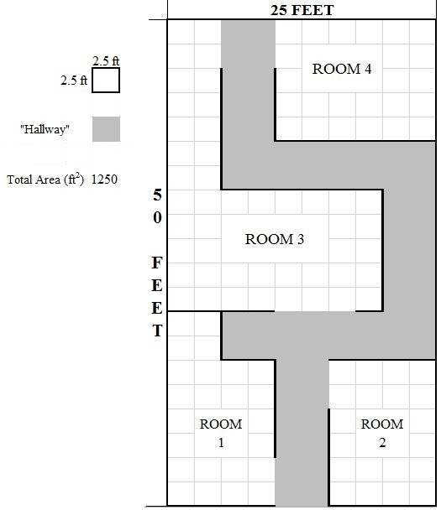
FlyNet: End of Semester Test
Setup:
Known blueprint of area
Set up in Fleming Vicon Cage
Multiple rooms
Includes various hallway types
Dead end
Left turn
Right turn

Slide 2
FlyNet: End of Semester Test
Unknowns:
Three “roadblocks” placed into map
4’ x 3’ wall
Placed into map
“Target” placed into map
“Roadblock”
“Target”

Slide 3
FlyNet: End of Semester Test
Tasks to Complete:
Explore entire map
Avoid all obstacles
Walls
“Roadblocks”
Return back to Entry Point with entire area mapped
“Roadblock”
“Target”
Entry/Exit Point

Slide 4
FlyNet: Doorway Test
Manual Flight Doorway Test:
Build an adjustable doorway
Incrementally decrease width of doorway
Find how narrow of a doorway the quadcopter can fly through
This result will be used during the End of Semester Test

Slide 5
FlyNet: Hardware Integration
Hardware:
ASUS Quadcopter
ASUS Xtion
Laser Range Finder
Jetson Dev Board
Teensy Board
ODROID XU4
Ultrasonics
Battery
Battery
ASUS Quadcopter
ASUS Xtion
(Mapping)
Teensy Board
ODROID XJ4
Autopilot
Laser Range Finder
Jetson
Ultrasonics

